Slide 1
A Quick Start Guide to Performing a Batch Static Light Scattering Experiment to determine Protein Molecular Weight with the DynaPro NanoStar
Light Scattering University
Wyatt Technology Corporation
Santa Barbara, California

Slide 2
Contact Us
If any questions arise as you perform an experiment with the DynaPro instrument, please do not hesitate to contact us:
Telephone:
  (805) 681-9009
Email:
  support@wyatt.com
Mail:
  Wyatt Technology, 6300 Hollister Ave., Santa Barbara, CA 93117

Slide 3
Introduction
The purpose of this Quick Start Guide is to provide detailed instructions to the operator of a DynaPro NanoStar for performing batch static light scattering experiments, determining the absolute molecular weight of small isotropically scattering macromolecules (e.g. proteins).
Please refer to the DynaPro NanoStar User’s Guide, the Dynamics software User’s Guide, and the Wyatt Technology website (www.wyatt.com) for important safety related information, as well as detailed information regarding the operation of the instrument and software, including theory and applications.

Slide 4
Procedure Outline
Clean and dry the NanoStar quartz cuvette.
Check the clean water count rate.
Measure Solvent Offset and validate DLS results.
Determine protein concentration.
Measure the protein sample, then:
  Validate results: Datalog grid; ACF; Homogeneity
  Calculate Molecular Weight from Static Light Scattering
Notes:
These instructions assume the instrument calibration constant is valid (from your Certificate of Performance, IQOQ, etc.).
See Section 4 of this binder on how to calibrate and manage your cuvettes.

Slide 5
I. Clean and Dry the NanoStar Quartz Cuvette
As a first step, it is necessary to thoroughly clean and dry the NanoStar quartz cuvette, both inside and outside.
If you are not familiar with the recommended Wyatt Technology cleaning and handling protocols for quartz cuvettes, please review the section on cuvette cleaning in the DynaPro NanoStar User’s guide or the Technical Note “Quartz Cuvette Cleaning Protocol” on the Wyatt Support Center.
If you do not have a copy of this manual or technical note, please download from the Wyatt Support Center (www.wyatt.com) or contact Wyatt Technical Support at support@wyatt.com or 805-681-9009.

Slide 6
II. Check the Clean Water Count Rate
Draw 1 mL of DI water into a disposable 1 mL plastic syringe; attach a 0.02 μm Anotop filter.
Discard the first few drops of filtered solvent, then flush approximately 800 μL of water through the filter into a clean Eppendorf vial.
Load approximately 10-100 μL of 0.02 μm filtered DI water into the quartz cuvette, depending on the cuvette volume used.
Insert the cuvette into the NanoStar, and close the lid.

Slide 7
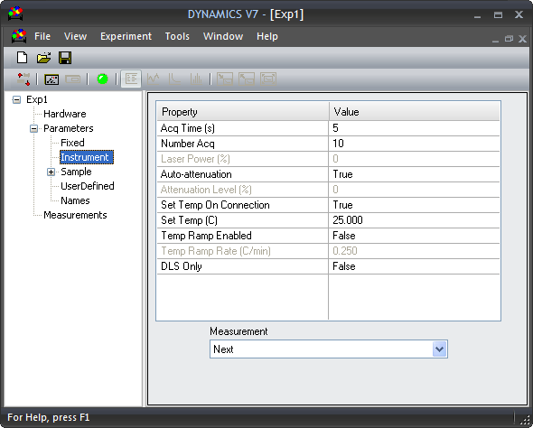
II. Check the Clean Water Count Rate
Open DYNAMICS:
  File → New
  Connect
  Enter the Parameters as shown.
  Press “Record”
1
4
2
3

Slide 8
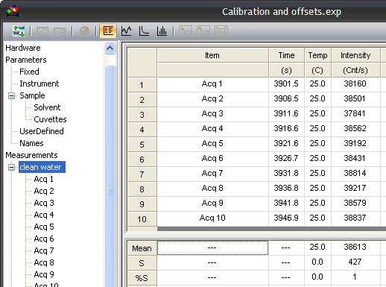
II. Check the Clean Water Count Rate
After the NanoStar has finished recording the results, check the datalog grid and autocorrelation functions.
The clean water count rate is expected to be equal or within 15% of the value of water or PBS shown on your instrument’s COP.
The variability of clean water over the 10 acquisitions is expected to be less than 5%.
The autocorrelation functions are expected to exhibit the characteristic pattern for a pure solvent.
1
2
3

Slide 9
II. Check the Clean Water Count Rate
If the clean water produces the expected results, clean and dry the cuvette prior to moving to Step 3.
If the clean water does not produce the expected results:
  Review Section 6.6 “Sample Preparation Troubleshooting” in the DynaPro NanoStar User’s Guide.
  Clean and dry the cuvette and repeat Step 2:
    If after repeating the procedure the clean water count rate is too low, make sure the cuvette is properly inserted;
    If after repeating the procedure the autocorrelation function indicates particles are present:
      Try a different source of water, as the water source may be contaminated.
      Rinse the cuvette with copious amounts of water especially if detergent was used to clean the cuvette.
      Make sure that all materials used are clean and free from dust (e.g. pipette tips, Eppendorf vials, filters…).
  Contact Wyatt Technology for assistance if these tips and suggestions do not resolve the issue.

Slide 10
III. Measure the Solvent Offset
Draw 1 mL of your solvent into a disposable 1 mL plastic syringe; attach a 0.02 μm Anotop filter.
Discard the first few drops of filtered solvent, then flush approximately 800 μL of water through the filter into a clean Eppendorf vial.
Load approximately 10-100 μL of 0.02 μm filtered DI water into the quartz cuvette, depending on the cuvette volume used.
Insert the cuvette into the NanoStar, and close the lid.

Slide 11
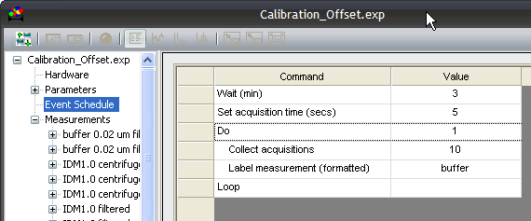
III. Measure the Solvent
Before recording the static light scattering data for the Solvent Offset, record the DLS data for the solvent.
Tip: Edit the Event Schedule to Label the Measurement, then press the Record button.
Take note of the Autocorrelation Function (ACF) determined for the Solvent to confirm it is particle free. If the Solvent is not particle free, the particles may influence both the DLS and SLS results and interpretations.
Particle free ACF (refer to the DYNAMICS User’s Guide, Section 8)

Slide 12
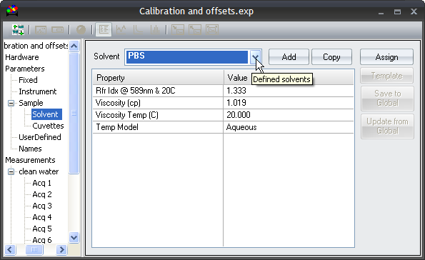
III. Measure the Solvent Offset
The next step in the experiment is to determine the scattering from the “blank” or “solvent”, without the analyte present.
The solvent scattering will be subtracted from the total sample scattering to determine the excess Rayleigh ratio, from which the molar mass will be determined.
Select Parameters → Sample → Solvent.
Then select the solvent from the drop down list.
If your solvent is not present, you may create a new solvent by clicking on Add (refer to DYNAMICS User’s guide).
2
3
1

Slide 13
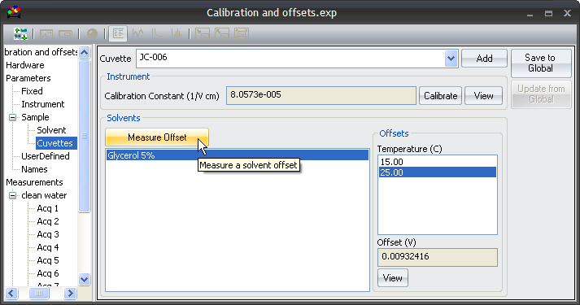
III. Measure Solvent Offset
Select Sample → Cuvettes.
Select your cuvette from the drop down list.
Click on Measure Offset.
2
1
3
Note:
Solvent Offsets must be measured for the temperature range of interest, e.g. measure the solvent offset at 15°C and 40°C for sample measurements between 15 and 40°C.

Slide 14
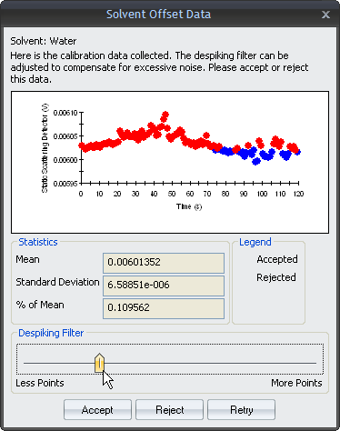
III. Measure Solvent Offset
The static scattering detector response will be displayed graphically as shown to the left.
Set the despiking filter such that the standard deviation as a % of the mean scattering is less than 0.05%, then press ok.
If the Despiking Filter is located at position 5 or lower (refer to the figure on the left), we recommend that you clean the cuvette and try again. The example shown does not pass the filter criteria.

Slide 15
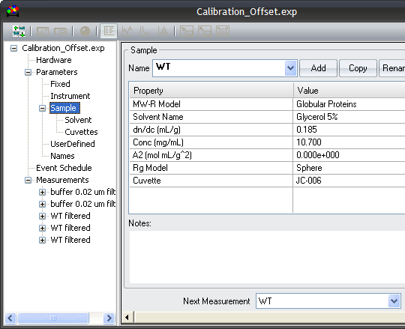
IV. Protein Concentration
Determine the concentration of your protein sample.
  Note: We recommend that the concentration be determined after the sample is spun or filtered, if necessary.
Enter the concentration in DYNAMICS in the Parameters → Sample → Conc (mg/mL) field as shown to the right.
Also, at this time, enter the standard or known dn/dc value for your sample (0.185 mL/g for unmodified proteins).

Slide 16
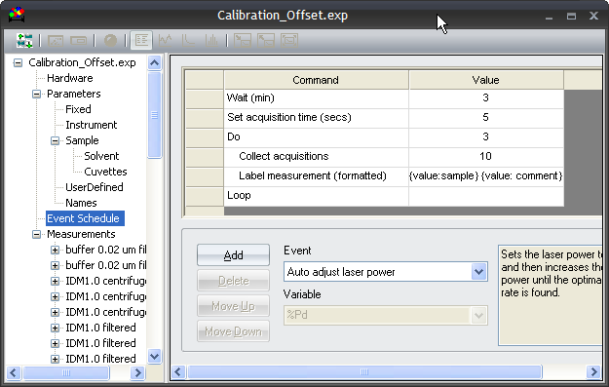
V. Measure the Protein Sample
Clean the quartz cuvette per previous instructions.
Load the protein sample into the quartz cuvette per operator’s manual, then place the cuvette into the NanoStar sample chamber.
Edit the Event Schedule to Label the Measurement (here the measurement is automatically labeled with the sample name), then press the Record button.

Slide 17
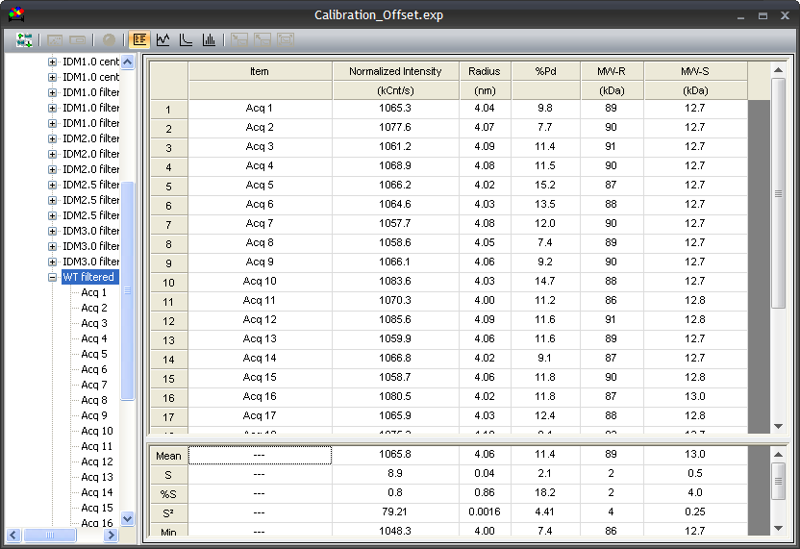
V. Measure the Protein Sample
Upon completion of the Event Schedule, review the data:
  Are the majority of acquisitions unmarked?
  Are the results consistent among all acquisitions (%S less than 10% for Normalized Intensity, Radius, Mw-S)?
  Is the average ACF valid? (refer to DYNAMICS User’s Guide).
    If the ACF indicates a dirty cuvette or sample, clean the cuvette and filter or spin your sample and try again.
  Is the intensity-weighted size distribution monomodal and homogeneous?
1
2
3
4

Slide 18
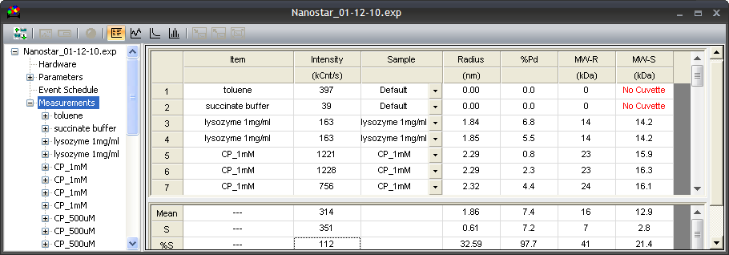
V. Measure the Protein Sample
2
3
1
The absolute molecular weight of the Protein Sample is displayed in the Mw-S column. This is the “weight average” molecular weight determined from static light scattering measurements.
The DLS data indicate a homogeneous size distribution, with %PD less than 15% as determined by the Cumulants algorithm.
The Mw-S results for Lysozyme agree with the estimated Mw-R determined from the measured radius of the protein, suggesting a globular conformation for this protein. The slightly larger Mw-R values compared to the Mw-S values for the CP-1mM protein suggests an elongated conformation.

